Slide 1
Comms Project
CLack
David Angel, Joseph Fujimoto, Madison Avila, Sean Alcantara, Sedat Altun,

Slide 2
Agenda
Refresher of Our Use Case
GUI Class/Client Layout
Full Class Diagram
Server Class / Server Handler Class
Logging
Extra Slides if needed

Slide 3
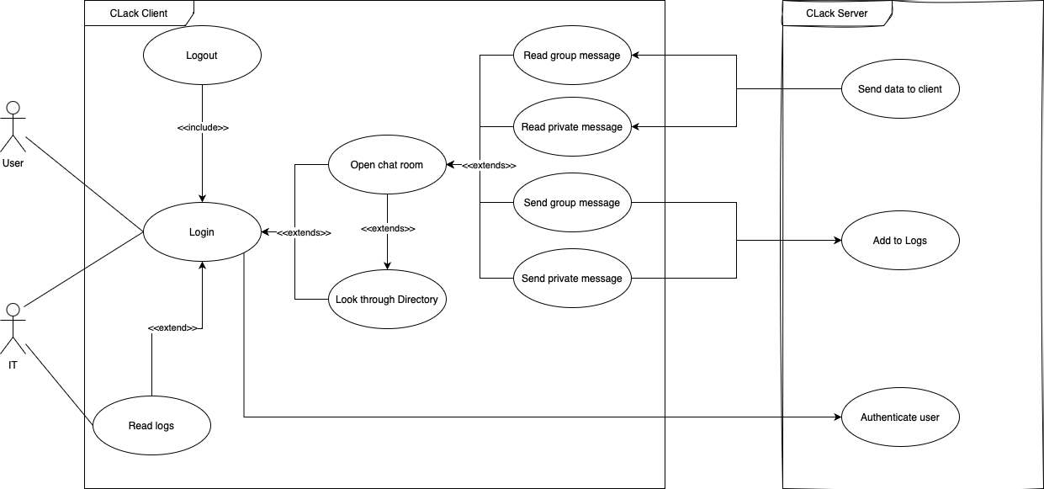
Use Case Diagram

Slide 4
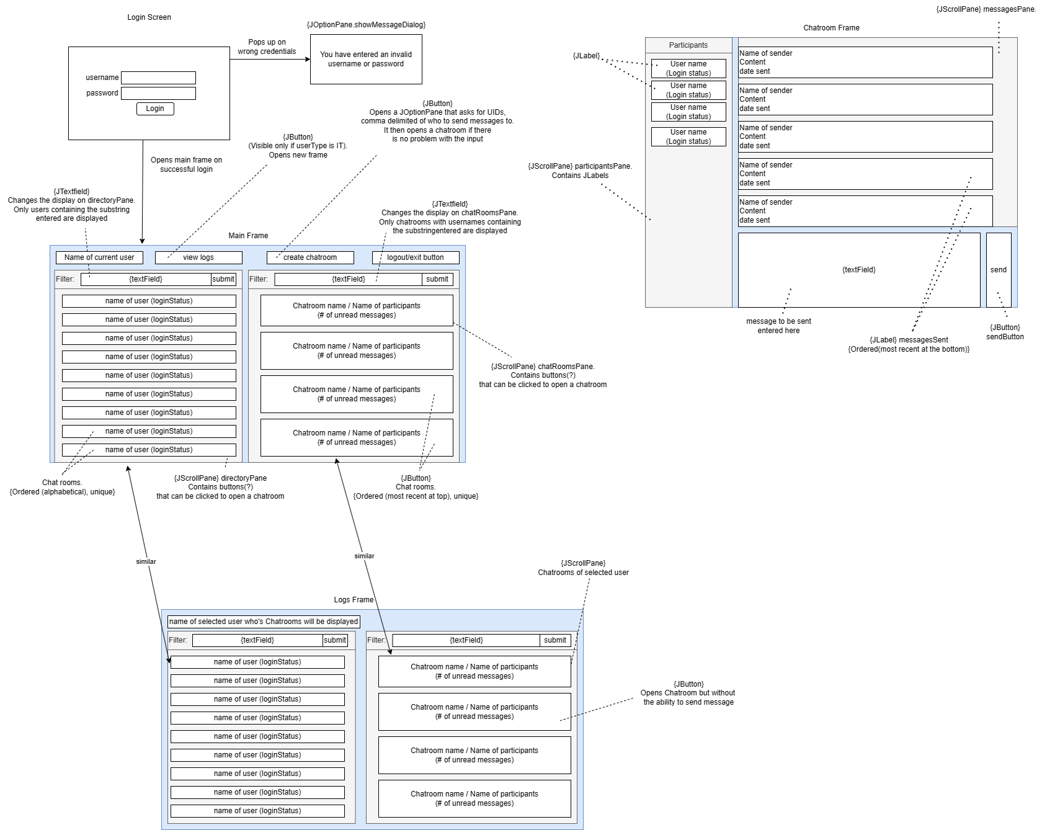
GUI Diagram

Slide 5
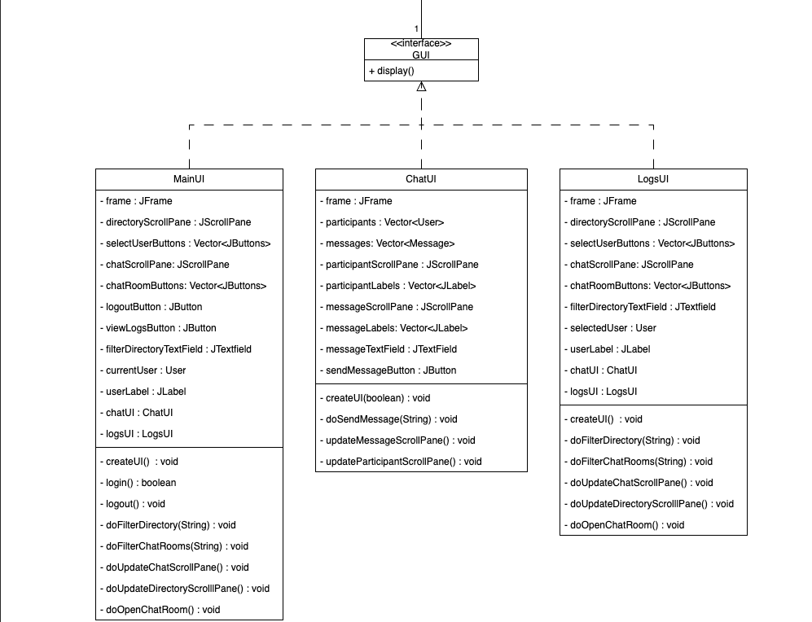
Class Diagram

Slide 6
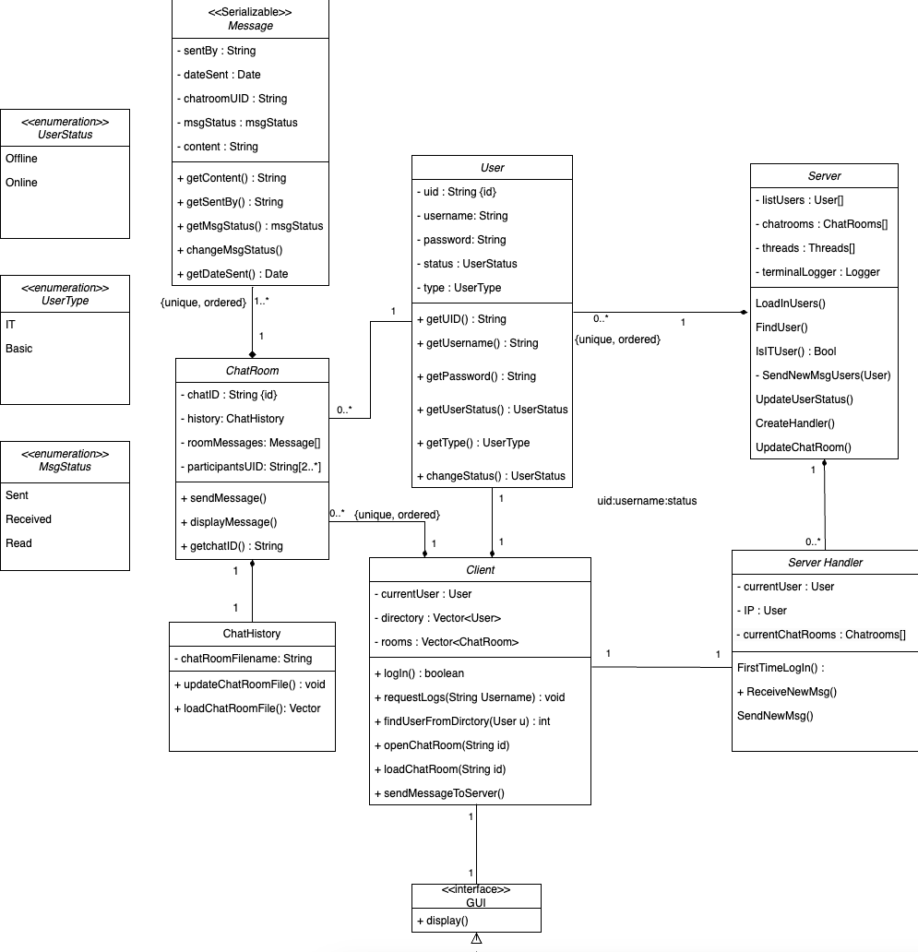
Class Diagram Continued

Slide 7
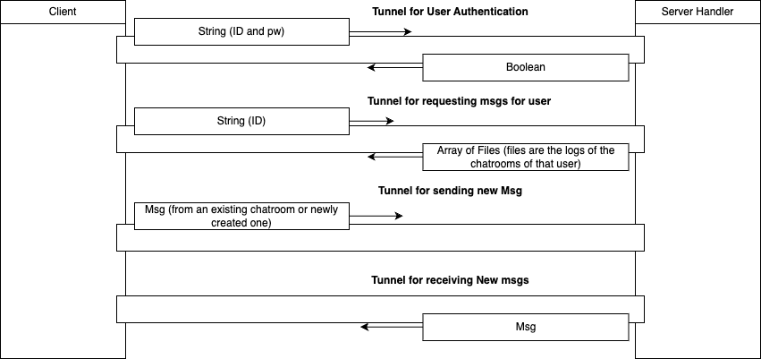
Server and Server Handler

Slide 8
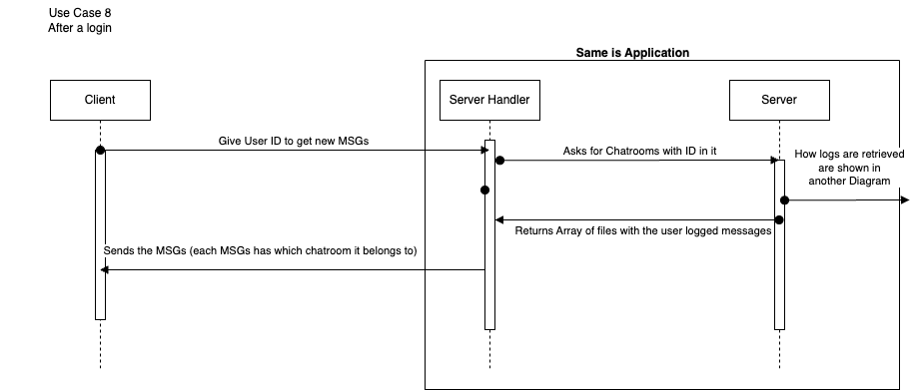
Server and Server Handler

Slide 9
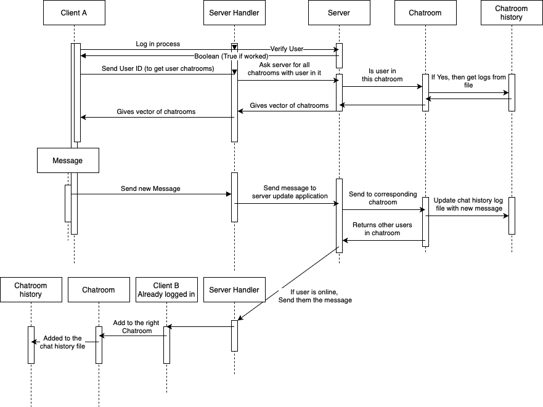
Logging

Slide 10
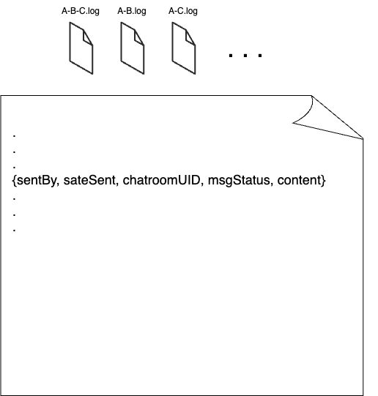
Logging file format

Slide 11
Thank you

Slide 12
Extra Slides

Slide 13
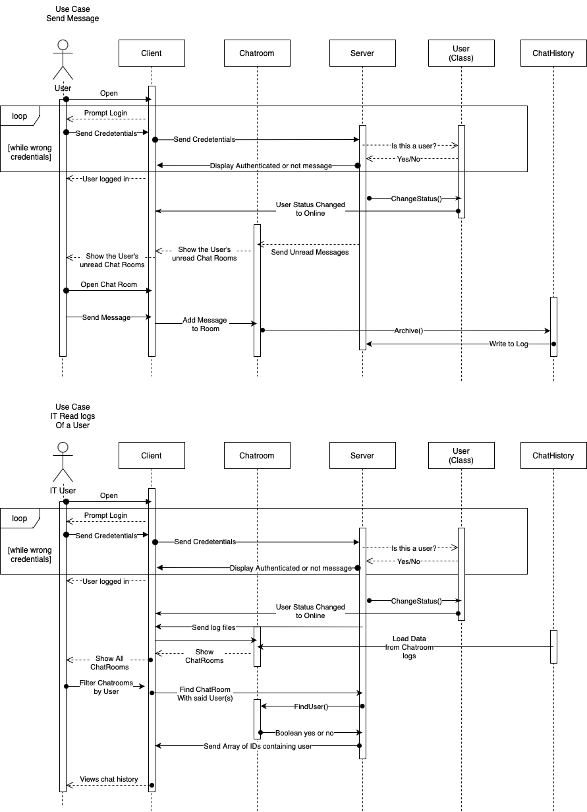
Sequence Diagram

